Slide 1
Sprint 3

Slide 2
Our Sprint 3 Goals
Finalize testing standards
Select input method for external processing
Begin familiarization with relevant software libraries
Choose microcontroller
Create purchase list
Document progress up to sprint 3

Slide 3
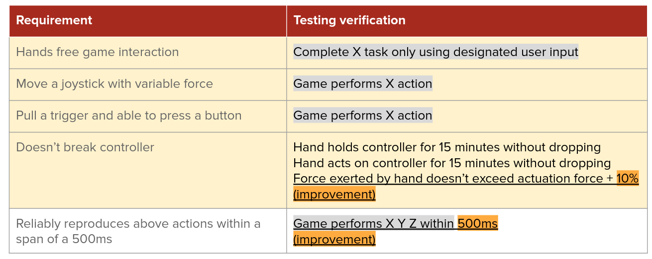
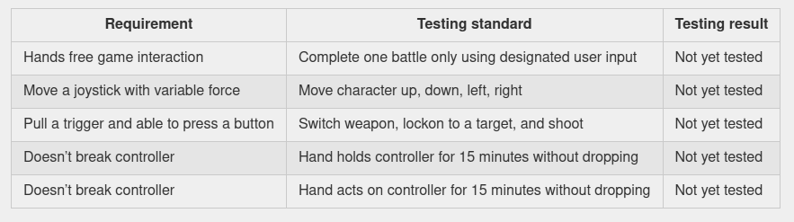
Testing Standards
Decisions:
Cuphead (modern, cooperative, platformer)
Xbox One controller (widely used and available)
Adjusted testing standards
Can designing system
Notes:
Goals don’t need to be legible, just to show that arbitrary filler goals are gone

Slide 4
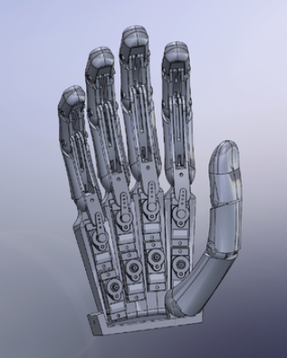
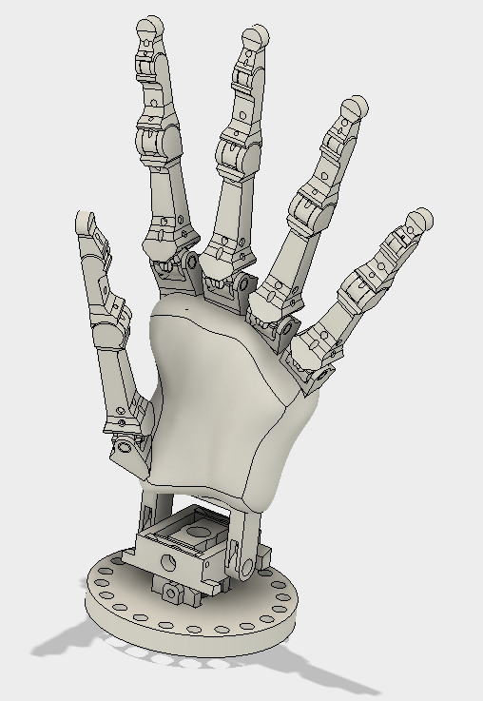
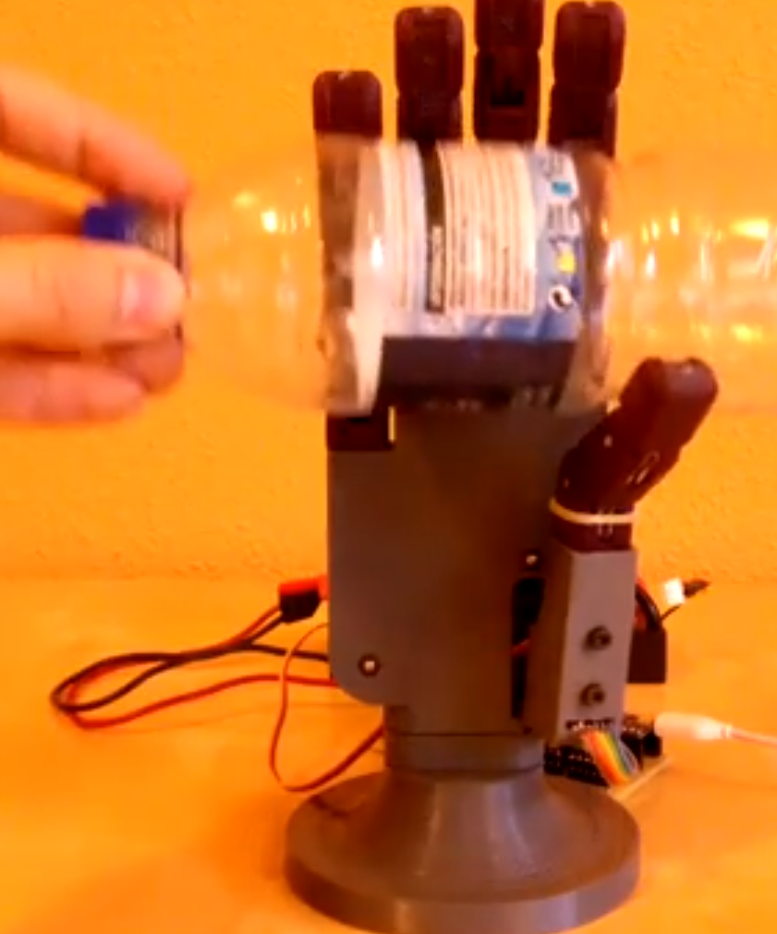
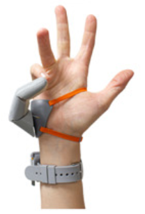
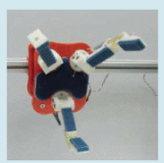
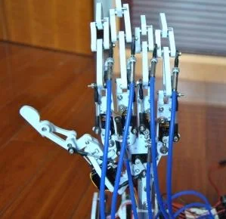
System Design - CAD
Open source/research designs
None meet our needs exactly (buildable, controller-friendly)
Need to brainstorm our design and adapt a current solution
Third Thumb
OpenHand
Leap Motion Animatronic
Hand
Anthropomorphic Hand
Dextra
NanoHand

Slide 5
Microcontroller
First Choice : Raspberry Pi 4
2GB
1.5-GHz, 4-core Broadcom BCM2711 (Cortex-A72)
2x USB 3.0
2x USB 2.0
1x Gigabit Ethernet
2x micro HDMI
802.11ac / Bluetooth 5.0
Backup Option: Raspberry Pi 3B+
1GB
1.4-GHz, 4 core Broadcom BCM2837B0 (Cortex-A53)
802.11ac / Bluetooth 4.2, Ethernet
4xUSB
2.0, HDMI, 3.5mm audio

Slide 6
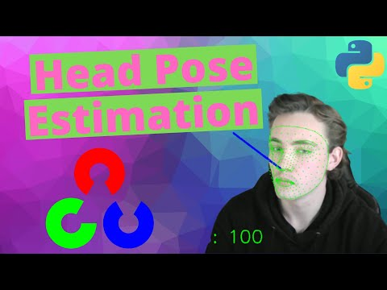
Input method for external processing
Selected input method: Head movements
Removes need for hand mobility altogether
Mitigates risk of designing for variability in mobility
More intuitive than voice control
Relevant Libraries:
Mediapipe
Dlib
OpenCV
Notes:
Mediapipe - developed by Google, python lib that offers open source cross-platform ML solutions for live and streaming media
Dlib - open source C++ library for ML algorithms
Already identified methods relevant to our application
OpenCV - solvePnP -
estimate the object pose given a set of object points, their corresponding image projections, as well as the camera intrinsic matrix and the distortion coefficients

Slide 7
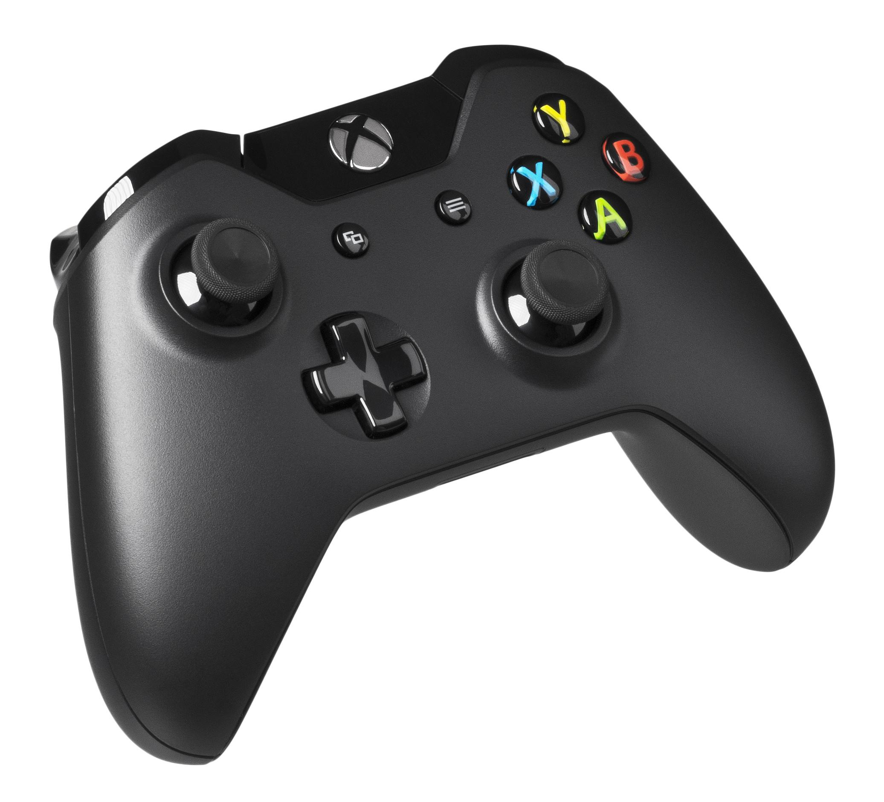
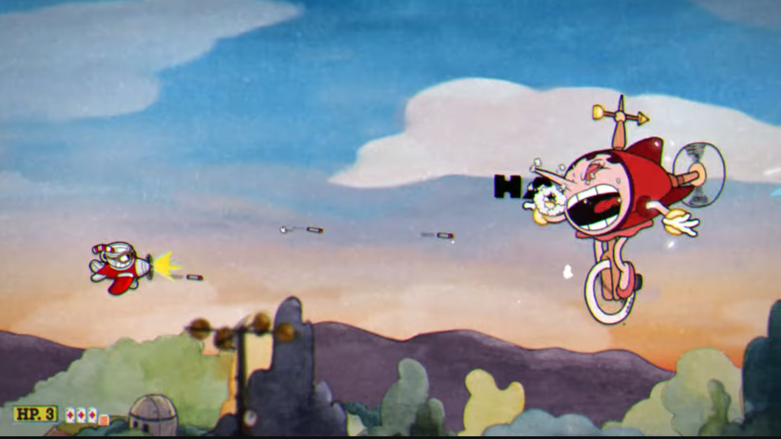
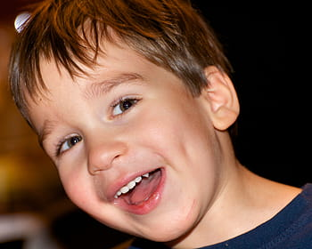
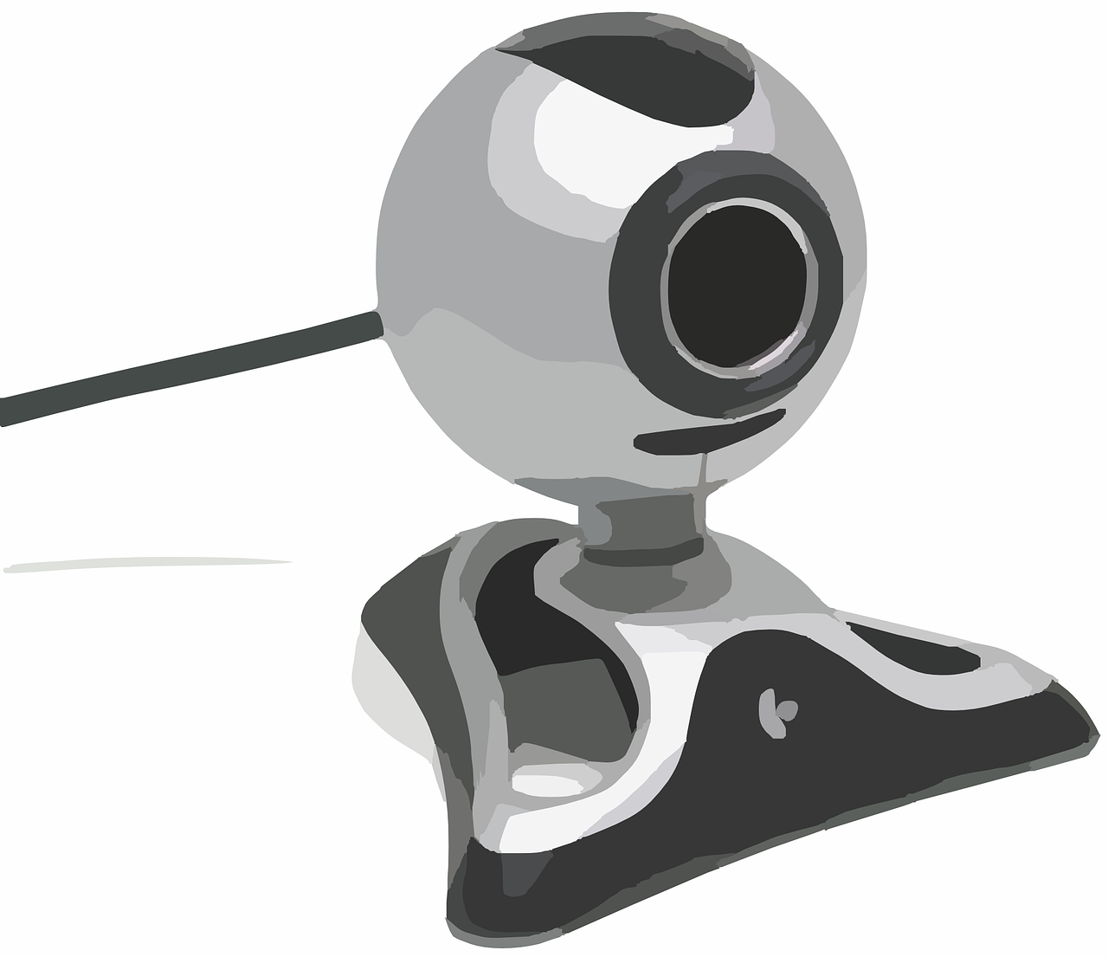
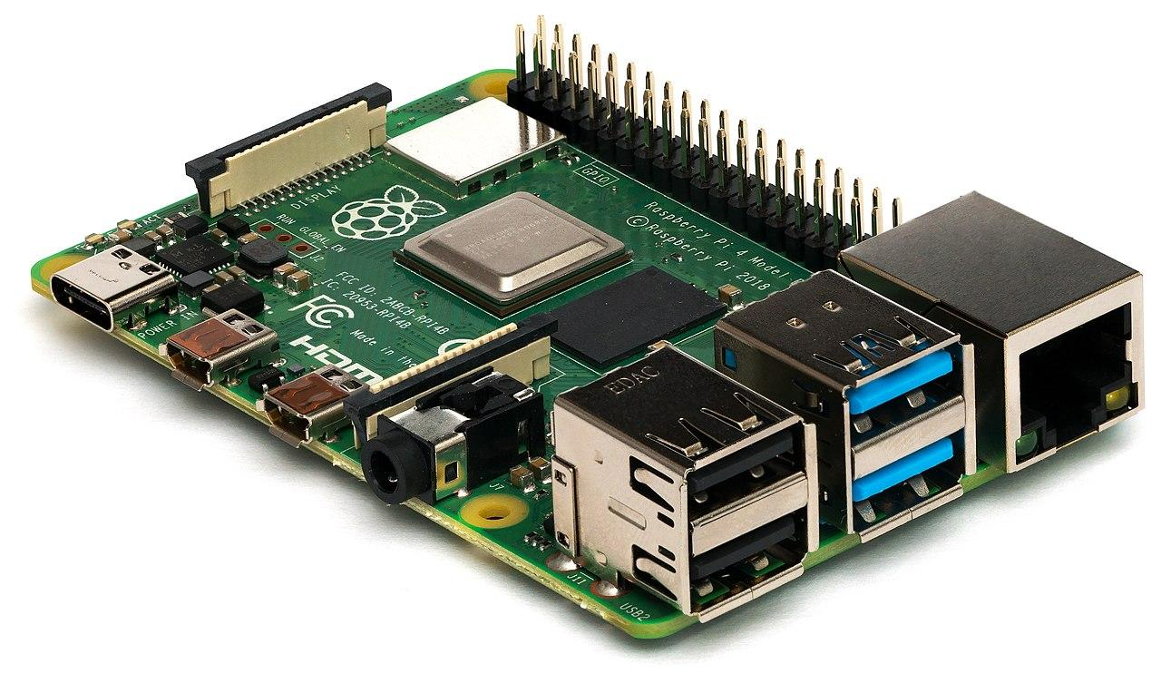
Recap: Informal Design Layout
TBD
TBD
Head positioning —> OpenCV —> Raspberry Pi 4B —> Robot Body —> Xbox One Controller —> Cuphead

Slide 8
Next Sprint Goals
Get a working CAD design
Choose actuator once we have working design
Have purchasing completed
Get head pose estimation functioning
Begin mapping controls
Setup computer

